Slide 1
Login + Chat

Slide 2
Decision on which Technologies to use:
We have decided to go with:
AWS Cognito for auth
Twillio for the chat

Slide 3
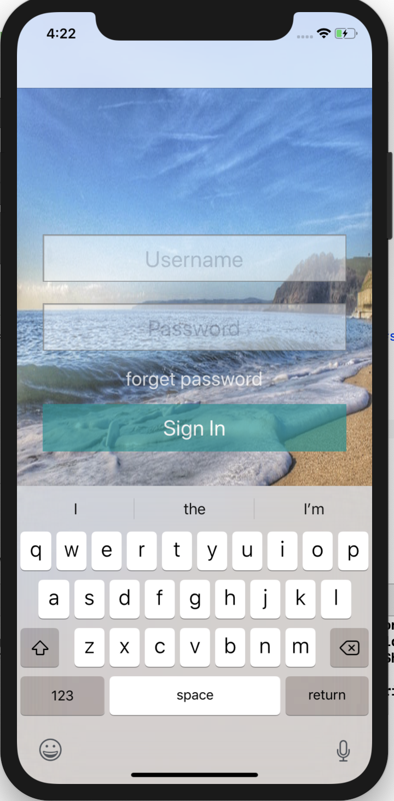
This Iteration (Progress)
+ Completed Login UI with programmed input-cancelling tap functionality
+ Added RootViewController for programmatic use
+ Added segue functionality to go to other views
+ Learning Cognito documentation and tried to figure out how to add users to the user-pools to enable user sign in
+ Learning Swift and XCode functionalities
+ Integrated Cognito Mobile SDK into the project (still a work-in-progress, see next slide)
+ Created temporary Cognito user-pools
+ Updated Login UI for very minor improvements (the forgot link is now below SignIn, and changed to Forgot Password?)
+ working MVP architecture

Slide 4
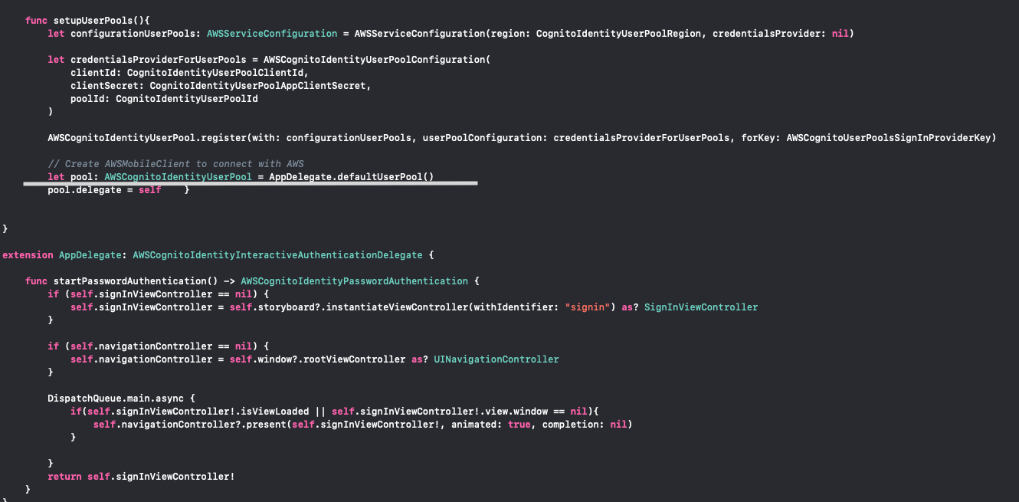
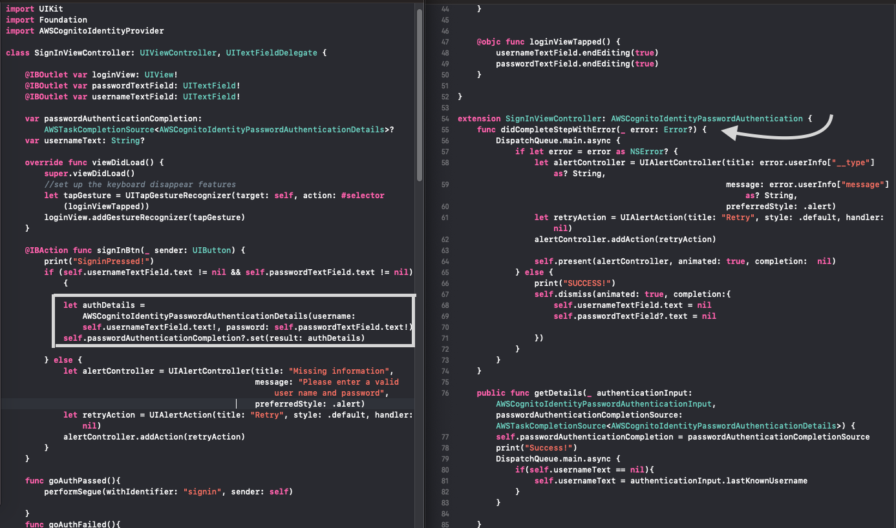
Iteration Challenges
Cognito has and uses its own AWSTaskCompletionSource, where the credentials, packed inside AWSCognitoIdentityPasswordAuthenticationDetails, are stored for the AppDelegate to pass to the declared AWSCognitoIdentityUserPool resource. However, we cannot find where exactly and what it provides for the application to consider the user authenticated.
Limitations: The sign-up must provide all the standard attributes specified in creating the user pool, otherwise it would produce an error.

Slide 5
Next Iteration (Plans and Goals)
Add forgot-password view and corresponding methods using AWS modules
Add remember-device functionality
Add some feedback after a user has been signed-up in the console (eg. Verify if user-details are inputted correctly into the console, by sending an email, link, etc.)
Grab Standard Attributes data(Full Name, birthday, phone-number) (if needed, check with sponsor)
If Cognito is added and made fully-functioning by this iteration, we plan to start on Chat using Twilio in the next iteration.

